Slide 1
Cardio Good Fitness Customer Analysis

Slide 2
Objective
To identify customer characteristics of three treadmill products: TM195, TM498 and TM798
To use the findings and insights to help provide recommendations and action items for Cardio Good Fitness in targeting potential customers

Slide 3
Data Information
Variable | Description
Product | The model no. of the treadmill
Age | No. of years of the customer
Gender | Gender of customer
Education | No. of education years of customer
MaritalStatus | Martial status of customer
Usage | Average no. of times customer wants to use treadmill every week
Fitness | Self rated fitness score of the customer
Income | Income of customer
Miles | No. of miles expected to run

Slide 4
Data Information
There are 180 samples of customer data
Among these, there are no missing data for each customer characteristics

Slide 5
Exploratory Data Analysis (EDA)

Slide 6
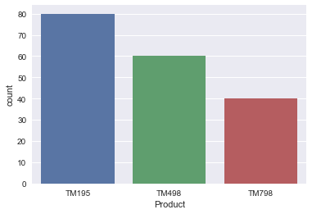
EDA - Product Count
There are more customers using TM195, followed by TM498, and then TM798
Users of TM195 are twice the number of users of TM798

Slide 7
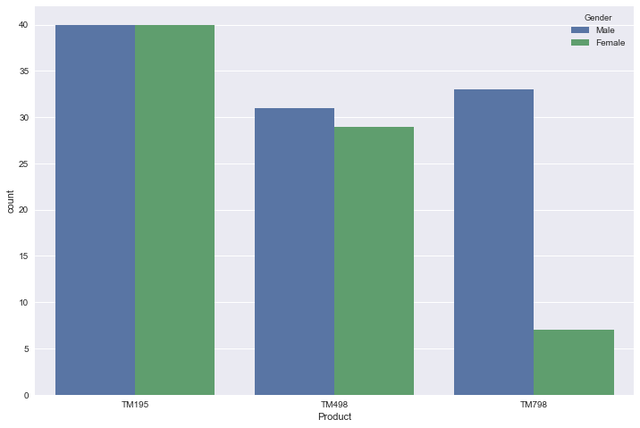
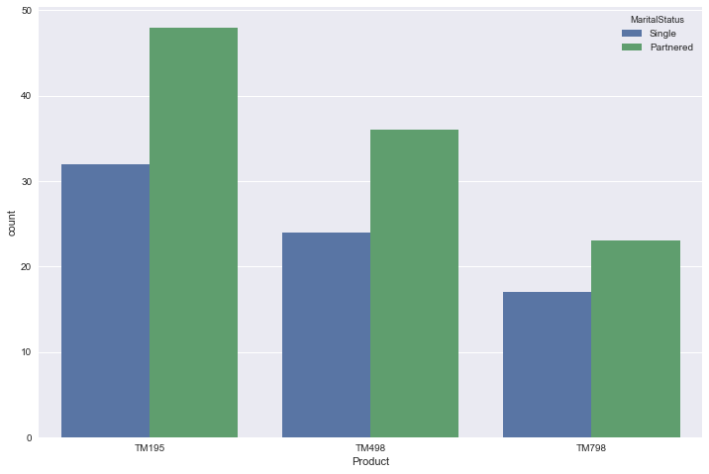
EDA - Product Count
Separated by Gender
Separated by Marital Status
There are significantly more male users for TM798
There are more married customers across the three products

Slide 8
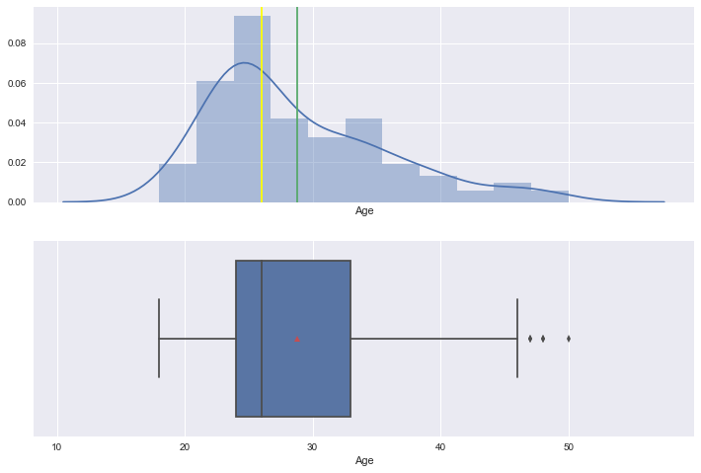
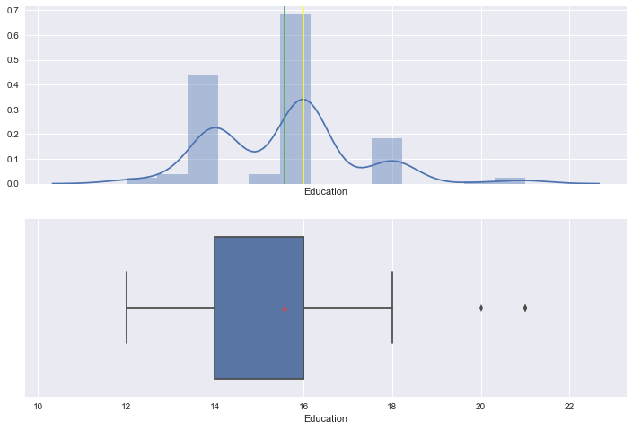
EDA – Age, Education
Age
Education
Users range from 18 to 50 years old.
Distribution is right skewed. Most users are between 24 to 33 years old.
At least 80% users have 14-16 years of education.

Slide 9
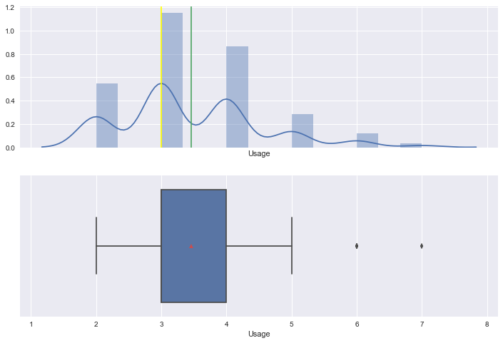
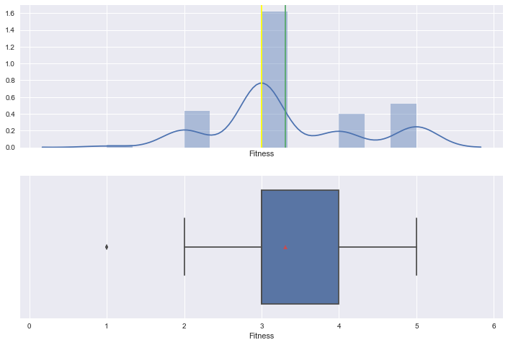
EDA – Expected Usage, Fitness Level
Expected No. of Usage/Week
Self Rated Fitness Level (out of 5)
67% of customers expect to use the treadmill 3-4 times per week
Around 50% of users rate their fitness level as 3 out of 5
There are more ratings of 4&5 than 1&2

Slide 10
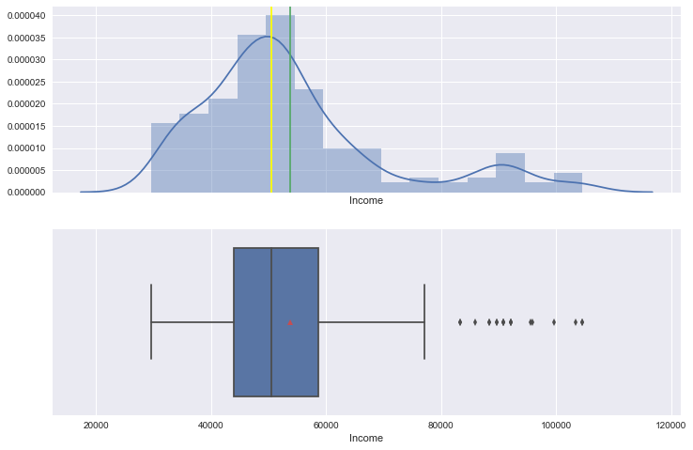
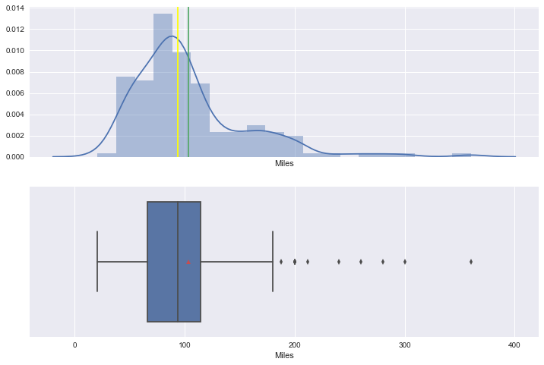
EDA – Income, Expected Miles
Income
Expected Miles to Run
Distribution is right skewed
Many have income between 44058.75 to 58668.0
Distribution is right skewed
On average, users expect to run 103.19 miles

Slide 11
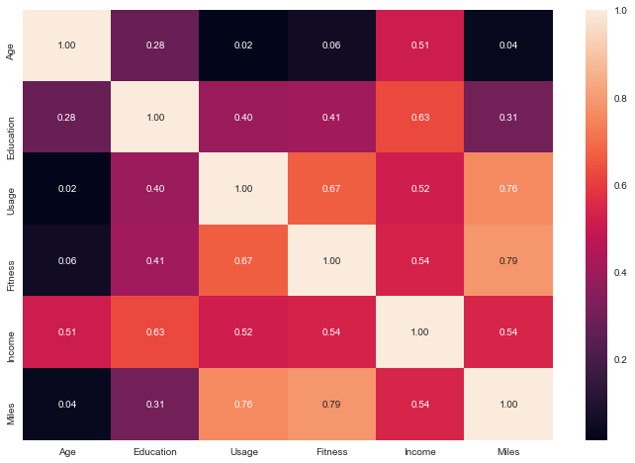
EDA – Correlation Matrix
Self rated fitness levels, expected miles, and usage of product correlate to each other well. It seems customers who are fit understand the importance of frequent exercise as a contributor to fitness levels.
As expected, income is correlated to education and age.
Income is somewhat correlated to self rated fitness level, expected miles and usage.

Slide 12
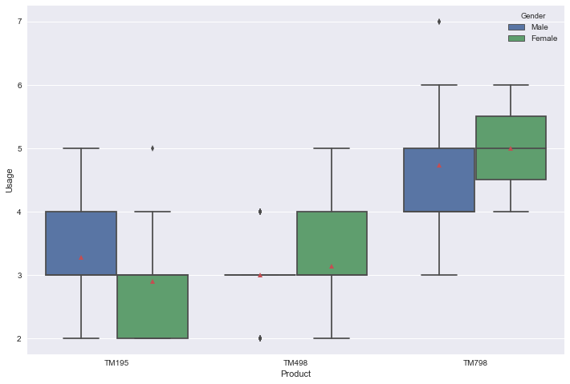
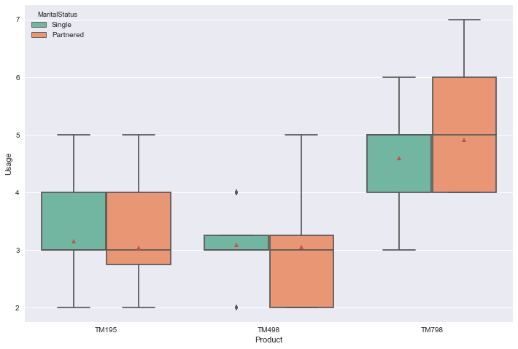
EDA – Expected Usage Across Products
Separated by Gender
Separated by Marital Status

Slide 13
EDA – Expected Usage Across Products
Users of TM798 expect to use the product more frequently, around 5 times per week on average.
Women expect to use TM798 slightly more often than men.
Married people expect to use TM798 slightly more than single people.
Users of both TM195 and TM498 expect to use the product around 3 times per week on average, regardless of marital status.
Men expect to use TM195 slightly more than women.

Slide 14
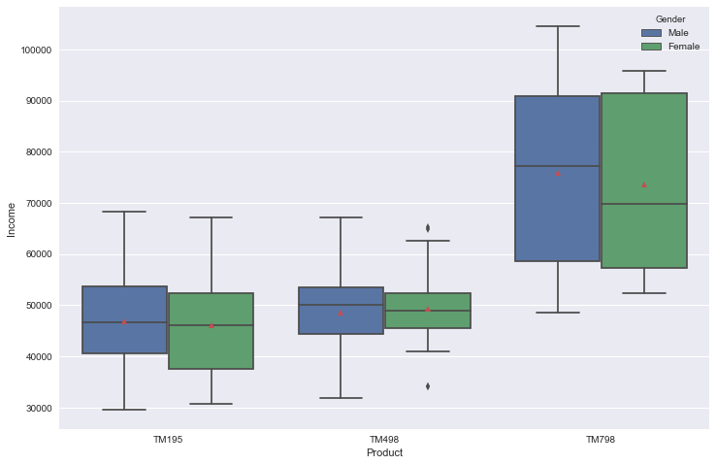
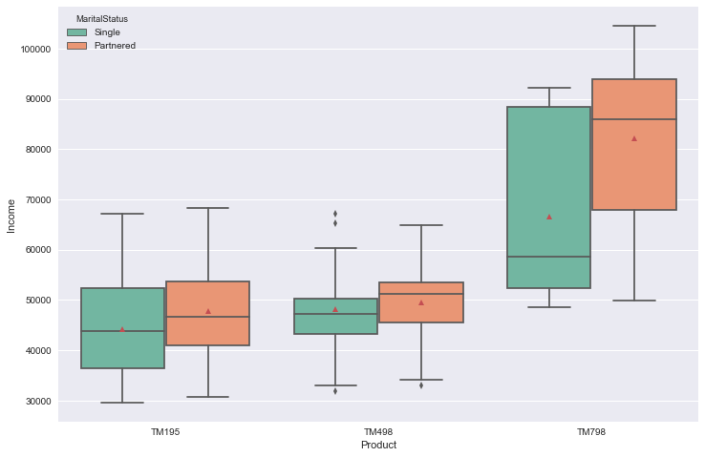
EDA – Income Across Products
Separated by Gender
Separated by Marital Status

Slide 15
EDA – Income Across Products
Users of TM798 are of people with higher income, 74551.575 on average.
Users of TM498 have an average income of 48973.65.
Users of TM195 have an average income of 46418.025, which does not differ much from TM498 users.
There aren’t much difference on income between men and women.
Married people generally have higher income compared to single people.

Slide 16
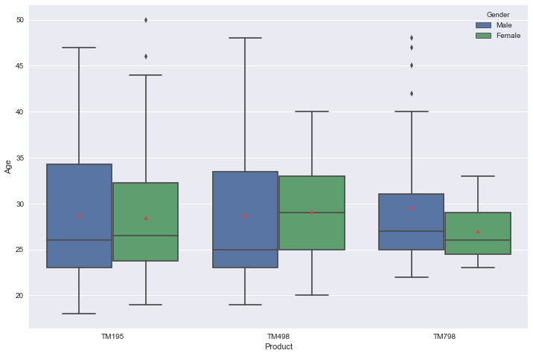
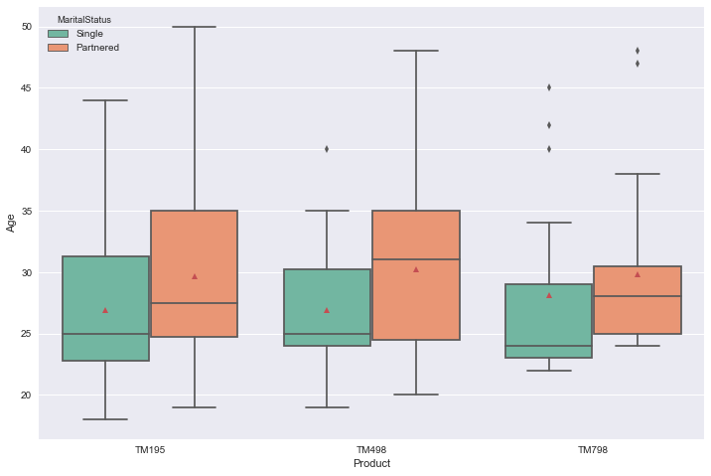
EDA – Age Across Products
Separated by Gender
Separated by Marital Status

Slide 17
EDA – Age Across Products
There aren’t any notable difference in age across the three products.
There aren’t any notable difference in age between men and women users.
The average age of married users across the products are around 30 years old.
The average age of single users across the products are around 27 years old.
It seems that most of the customers of the three products are between 23 and 35 years of age, which is the period of early-stage career for young adults.

Slide 18
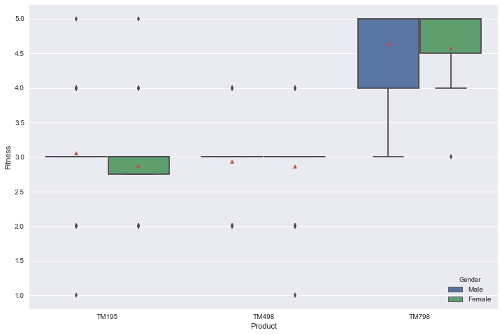
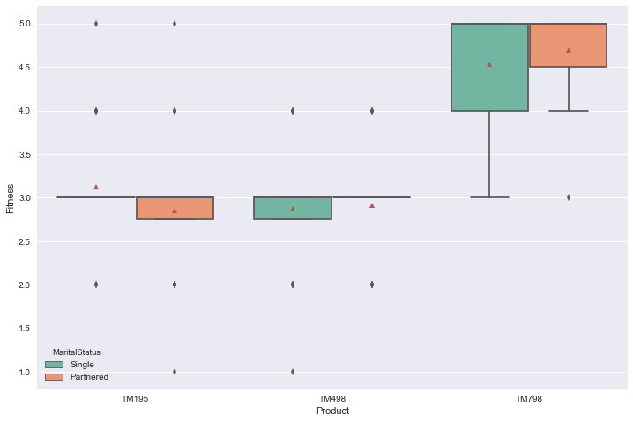
EDA – Self Rated Fitness Level Across Products
Separated by Gender
Separated by Marital Status

Slide 19
EDA – Self Rated Fitness Level Across Products
Users of TM798 gave higher rating of personal fitness level, which is 4.625 out of 5 on average.
Users of TM195 and TM498 have a similar rating of personal fitness level, which is around 2.9 out of 5 on average.
Men rated themselves around 3.5 out of 5 on average for fitness level, while women rated themselves around 3 out of 5 on average.
There are no considerable difference on self rated fitness level for single and partnered people.

Slide 20
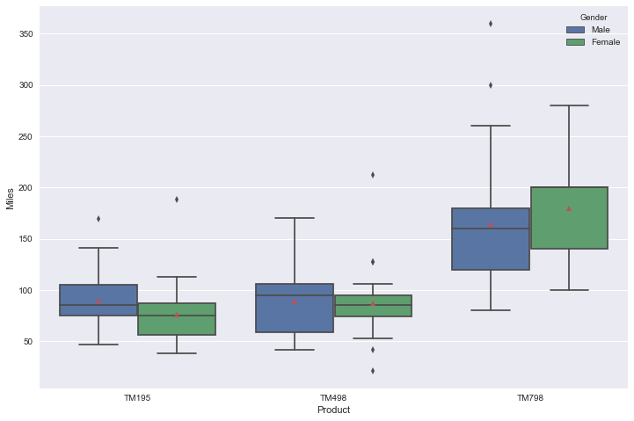
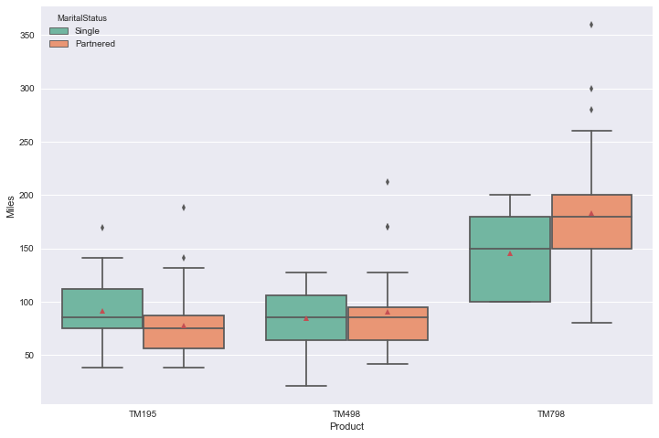
EDA – Expected Miles Across Products
Separated by Gender
Separated by Marital Status

Slide 21
EDA – Expected Miles Across Products
Users of TM798 expect to run more miles with the product, which is around 167 miles on average. Generally, women users of TM798 expect to run more miles compared to men and married people expect to run more miles compared to single people.
Users of TM498 expect to run around 88 miles on average. There are almost no difference between male and female, single or partnered users in expectation of miles to be run for TM498 product.
Users of TM195 expect to run around 83 miles on average. Single users of TM195 expect to run more compared to married users of TM195. Male users of TM195 expect to run more miles compared to women users of TM195.

Slide 22
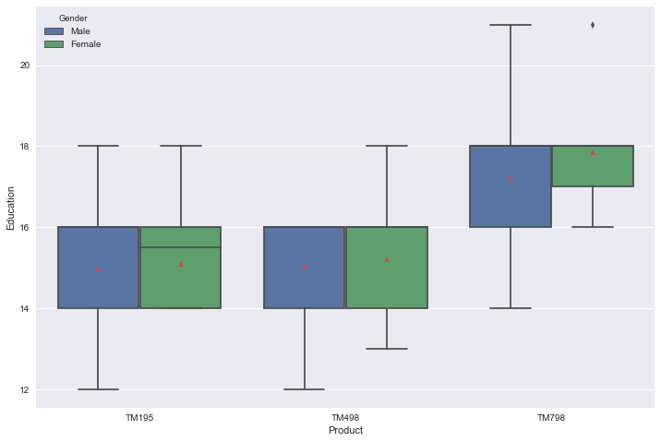
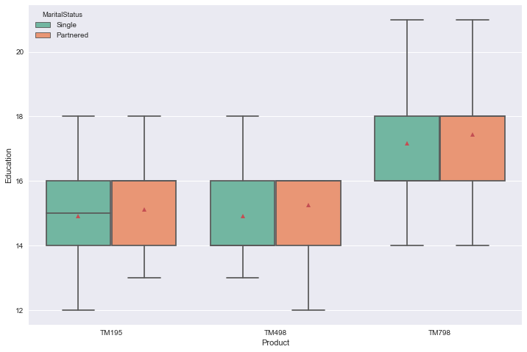
EDA – Education Across Products
Separated by Gender
Separated by Marital Status

Slide 23
EDA – Education Across Products
Users of TM798 have more education years compared to users of other products. Users of TM798 have an average of around 17 education years. On average, women users of TM798 have slightly higher education years compared to men (although the amount of women users are negligible compared to men), while there are no significant difference between single and married people.
Users of both TM195 and TM498 have around 15 years of education on average, whether across gender or marital status.

Slide 24
Conclusion
Users of TM798 stand out from the other two users. They are generally male with higher income, education and fitness level, who will use the product regularly.
Users of TM195 and TM498 have lower income and expectation of product usage as well as fitness level. There aren’t any significant difference of customer characteristics between these two products.
Many users are between 23 to 35 years old, with 29 years as average.
There are more TM195 users, with twice the amount of TM798 users.
Married users are around 1.5 times single users.

Slide 25
Recommendations
Marketing should be catered differently for these two different segments:
TM798 should be marketed as a premium quality unit with many features, to attract people with more income and expected frequency of product usage. It can be potentially marketed to gyms as well, as a reliable product for very frequent usage.
TM195 and TM498 can be marketed as a value for money option, with sufficient basic needs.
Marketing should be primarily targeted towards young people, who are around 35 years old and below.
It is advised to prepare more units/stocks for TM195 as there is higher demand for this product.

